Slide 1
Introduction to Deep Learning on ShARC and DGX-1 Day 2
Twin Karmakharm
23rd February 2017

Slide 2
For Slides and Lab materials
http://gpucomputing.shef.ac.uk/education
“More” link under -> Introduction to Deep Learning on ShARC DGX-1

Slide 3
Course content
Day 1
Lab 00: Getting started
Machine Learning and Neural Network Refresher
Introduction to Deep Learning
Lab 01: A simple Neural Network model for MNIST classification
Lab 02: Convolution Neural Networks
Lab 03: Deploying Your Trained Network

Slide 4
Course content
Day 2
Lab 04: Using and Visualising Pre-trained Models
Lab 05: Deep Learning with multiple GPUs
Lab 06: Recurrent Neural Networks

Slide 5
4. Using and visualising pre-trained model

Slide 6
Using pre-trained models
ImageNet dataset is 55GB and can take a week to train!
150,000 images
1,000 categories
A pre-trained model only needs the weights (~240MB for Alexnet)
It’s possible to use pre-trained model to improve convergence time in your own dataset
Also possible to repurpose the network for a different function
But if additional classifier is needed you will need to re-train the model

Slide 7

Alexnet
5 Convolution stages with 2 dense layer at the end

Slide 8
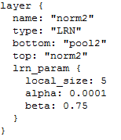
Alexnet
Addition of “Local Response Nomalisation” layer after pooling
Causes lateral inhibition in activations
Amplifies excited neurons and subdue surrounding neurons

Slide 9
Alexnet
We’ll be using the Caffenet which is Caffe’s reference model for Alexnet

Slide 10
Caffenet - Preparing your data
Pre-built models should provide their input format and mean values
Crop image
Subtract mean from data (when using pre-built model)
Means image in shape [C=3,H=227,W=227]
Already in BRG format
values (0-255)
We can just average the colour of the whole mean image: B: 104.0069879317889 G: 116.66876761696767 R: 122.6789143406786

Slide 11

Caffenet - Preparing your data
Mean image:

Slide 12
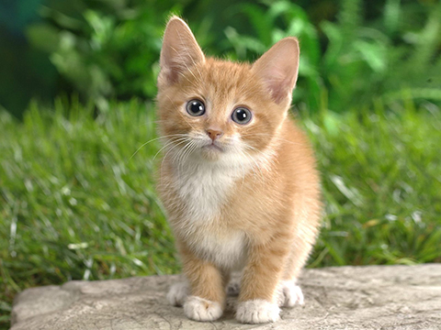
Caffenet – Classify &Visualise
Classify with:

Slide 13
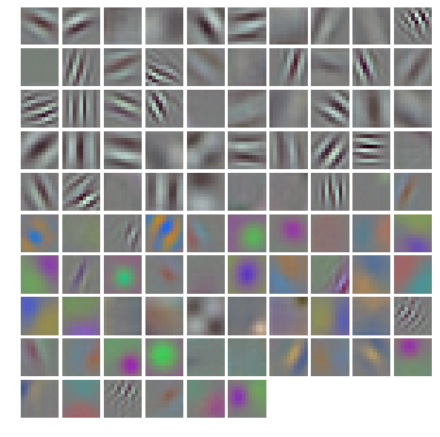
Caffenet – Visualisation
Weights and bias – what features are we detecting?
conv1 weights

Slide 14
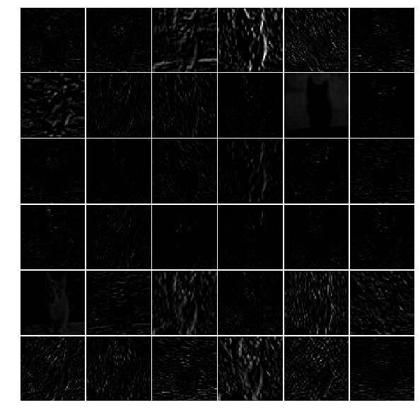
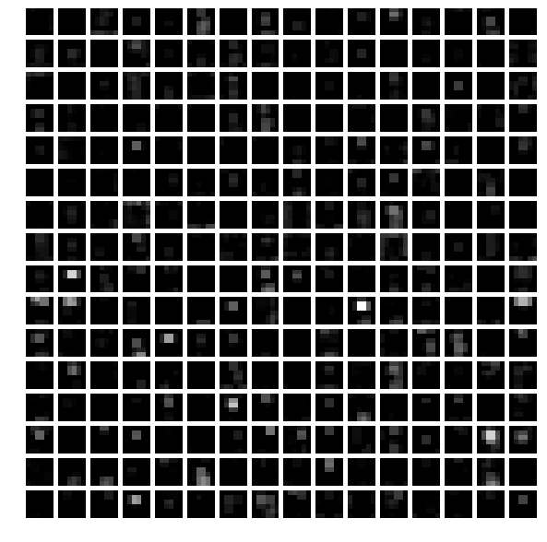
Caffenet – Visualisation
Outputs – Which neuron activated?
conv1 output
pool5 output

Slide 15
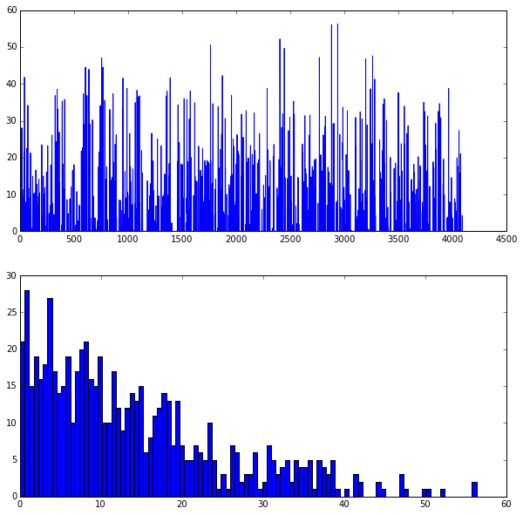
Caffenet – Visualisation
Dense layer fc6 (4096 neurons)
Top – Activations of each neuron
Bottom – Histogram of activation values
fc6 histogram

Slide 16
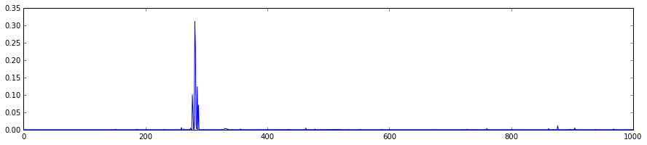
Caffenet – Visualisation
Output probability distribution
Labels sorted by semantics
output probability distribution

Slide 17
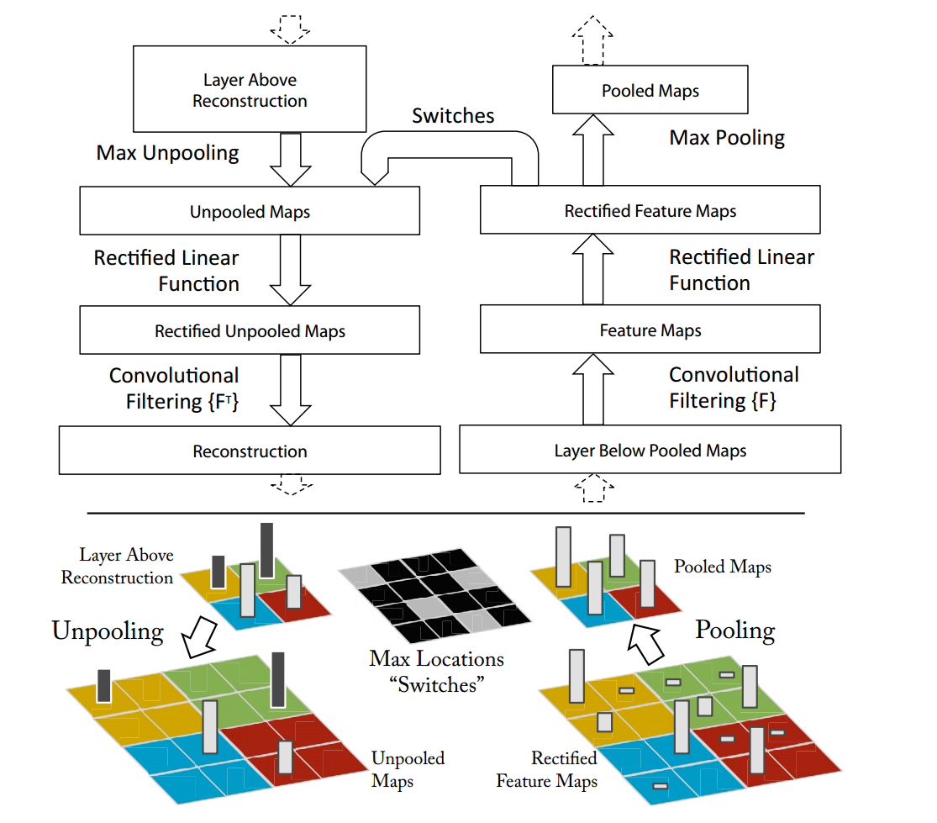
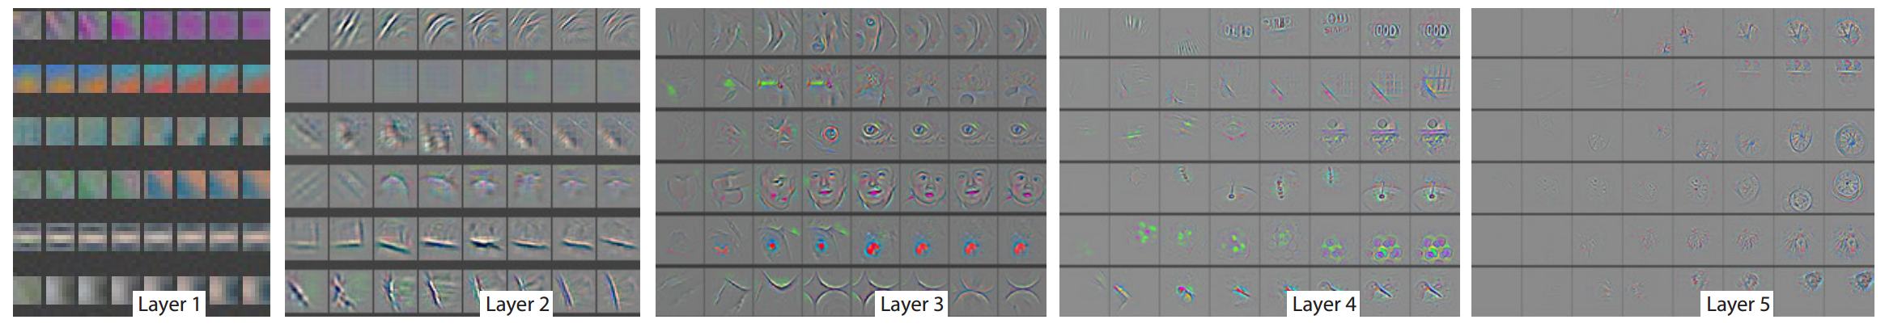
Visualisation – Going further
Visualizing and Understanding Convolutional Networks [Zailer et al. 2014]

Slide 18
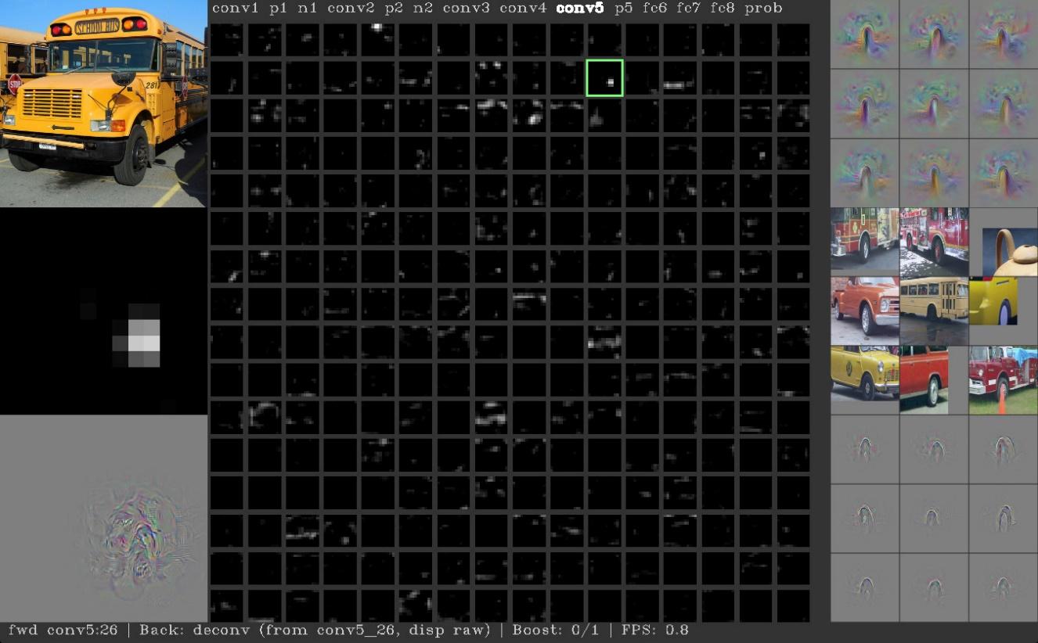
Visualisation – Going further
Understanding Neural Networks Through Deep Visualization [Yosinki et a. 2015]
Deep visualisation toolbox https://github.com/yosinski/deep-visualization-toolbox

Slide 19
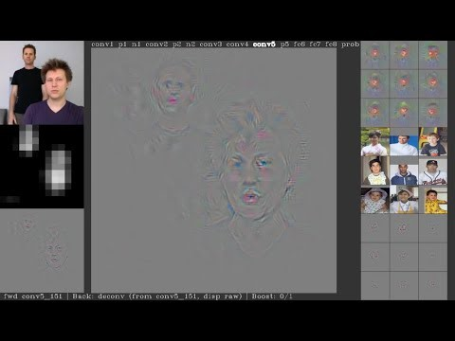
Visualisation – Going further
Understanding Neural Networks Through Deep Visualization [Yosinki et a. 2015]
Deep visualisation toolbox https://github.com/yosinski/deep-visualization-toolbox

Slide 20
Practical Lab 04

Slide 21
5. Training using multiple GPUs

Slide 22
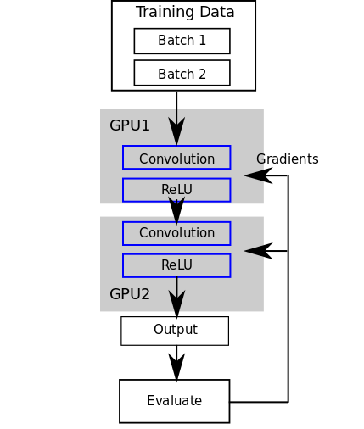
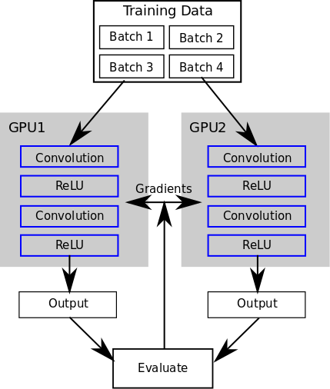
Training using multiple GPUs
Model parallelism – Synchronise inputs/outputs
Data parallelism – Synchronise weights
[https://blog.rescale.com/deep-learning-with-multiple-gpus-on-rescale-torch]

Slide 23
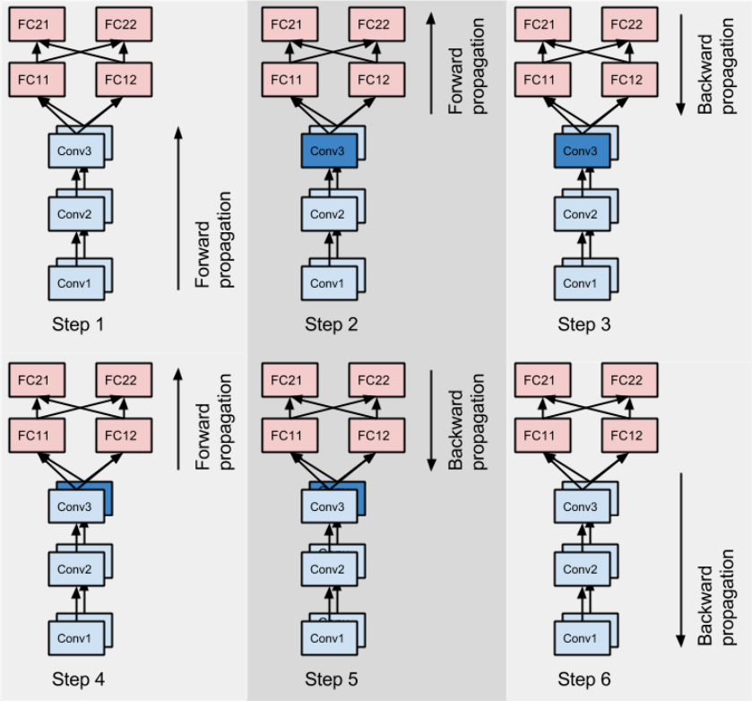
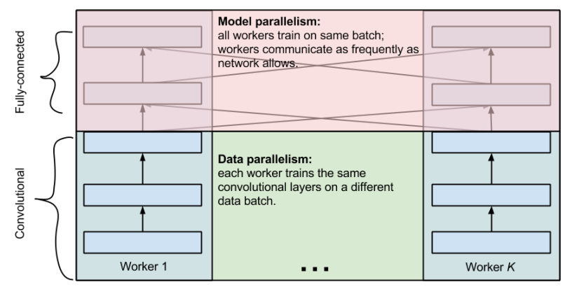
Training using multiple GPUs
It’s also possible to use a mixture [Krizhevsky 2014]
Convolution: ≈90-95% computation ≈ 5% parameters, large representation
Fully connected: ≈ 5% computation, ≈ 90-95% parameters, small representation

Slide 24
Training using multiple GPUs
Model parallel allows models larger than individuals GPUs to be run
Caffe does not support this
But you can do it on Theano, Torch and Tensorflow
Data parallel conceptually easier to implement
Weights averaged at end of batch
Beware of synchronisation cost!
Training time vs. Synchronisation time
On smaller models it may even take longer to synchronise than to train

Slide 25
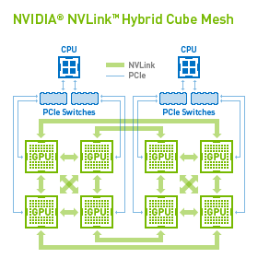
Training using multiple GPUs
Synchronisation can be performed directly from GPU to GPU
Requires NVLink connection
Check your GPU connection topology
Check with nvidia-smi topo –matrix
GPUs connected with NVLink will be faster than through PCI
E.g. Training on GPU 0 & 1 will be faster than GPU 2 & 4

Slide 26
Training using multiple GPUs
SGE Scheduler
Will try to allocate consecutive cards when possible
But not guaranteed when busy
Tier 2 system you will get the whole DGX-1 Node

Slide 27
Training using multiple GPUs
Caffe has built-in data parallelism support on command line using the gpu flag
E.g. caffe train –solver solver.prototxt –gpu 0,1
Or caffe train –solver solver.prototxt –gpu all
Multi-gpu for training only and through the command line and C++ interface, not Python

Slide 28
Benchmarking
Computation time scale linearly by iterations
Use caffe time to benchmark your model $ caffe time -model code/lab05/mnist_lenet.prototxt -iterations 10

Slide 29
Practical Lab 05

Slide 30
6. Recurrent Neural Networks
A simple text generation model

Slide 31
Recurrent Neural Networks (RNN)
Where models of sequential data is important: automatic speech recognition, machine translation, natural language, …
Recurrent Neural Networks (RNN) can handle these types of problems as they have ‘memory’
Also called Elman network (Finding structure in time, Elman 1990)

Slide 32
Application of RNNs: Language modeling
Statistical language modeling is one of the oldest and most important NLP tasks
The language models are core of machine translation, speech recognition and many other applications
Historically, it was amazingly difficult to convincingly beat N-grams, especially on larger than tiny datasets

Slide 33

RNN & Data Sequences
One to many (sequence output) e.g. captioning an image with multiple words
Many to one (sequence input) e.g. sentiment analysis
[http://karpathy.github.io/2015/05/21/rnn-effectiveness]

Slide 34
RNN & Data Sequences
Many to many (sequence in and out) e.g. Machine translation such as translating an English sentence to a French one
Many to many (synced sequence in and out) e.g. Video classification for labelling frames in a video
[http://karpathy.github.io/2015/05/21/rnn-effectiveness]

Slide 35
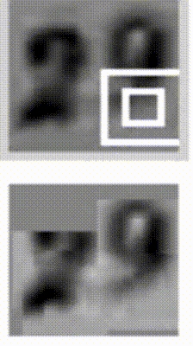

RNN & Data Sequences
Can be used in absence of a sequence
RNN Learns to read house numbers
RNN Learns to paint house numbers
[Ba et al. 2015]
[Gregor et al. 2015]
[http://karpathy.github.io/2015/05/21/rnn-effectiveness]

Slide 36
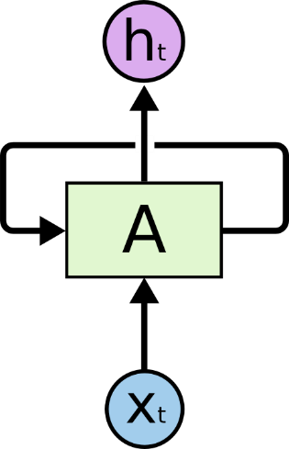
RNN - Architecture
Recurrent network has loops
In theory can lean to represent unlimited memory
[http://colah.github.io/posts/2015-08-Understanding-LSTMs]

Slide 37

RNN - Architecture
An unrolled RNN
[http://colah.github.io/posts/2015-08-Understanding-LSTMs]

Slide 38
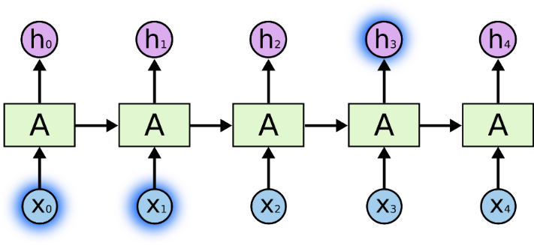
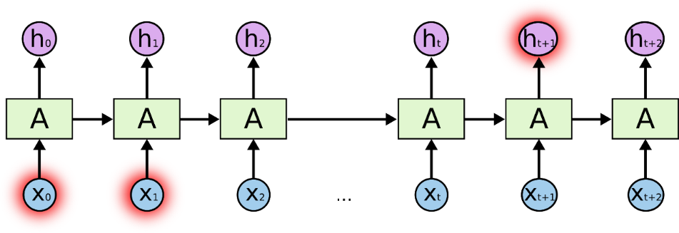
RNN - Architecture
The basic approach has problems with
Vanishing gradients - As we propagate the gradients back in time, usually their magnitude quickly decreases
Long term dependencies – Cannot connect information too far back in time
[http://colah.github.io/posts/2015-08-Understanding-LSTMs]

Slide 39
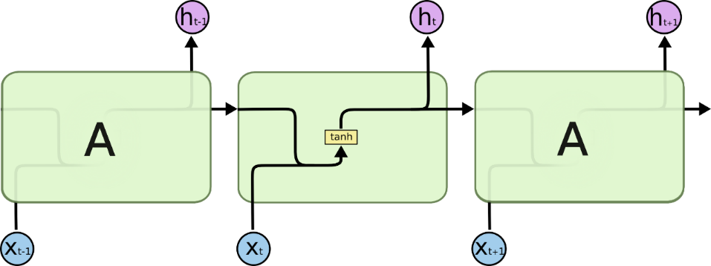


RNN - LSTM
Long Short Term Memory network (LSTM) can help the long-term dependency problem
Standard RNN, single layer
LSTM, has four interacting layers
[http://colah.github.io/posts/2015-08-Understanding-LSTMs]

Slide 40

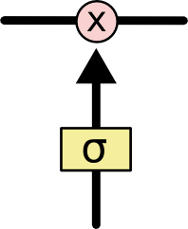
RNN - LSTM
Cell states perform simple linear operations
3 gates optionally let information though and controls the cell state
Has sigmoid activation functions
[http://colah.github.io/posts/2015-08-Understanding-LSTMs]

Slide 41

RNN - LSTM
Decide if we’re keeping this information
Is it the same context/subject?
[http://colah.github.io/posts/2015-08-Understanding-LSTMs]

Slide 42
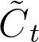

RNN - LSTM
Decide what new information to store
Input gate layer decides the value to update
tanh layer generates a vector of new candidate values
[http://colah.github.io/posts/2015-08-Understanding-LSTMs]

Slide 43
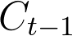


RNN - LSTM
Update old cell state in to new cell state
[http://colah.github.io/posts/2015-08-Understanding-LSTMs]

Slide 44

RNN - LSTM
Decide the output
[http://colah.github.io/posts/2015-08-Understanding-LSTMs]

Slide 45
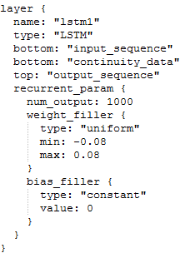
Caffe’s LSTM layer
Inputs
A sequence of features
TxNx….
A sequence of continuity/clipping data
TxN
Output
A sequence of predictions
TxNx….

Slide 46
Caffe’s LSTM layer
T is the time step
N are independent streams
Continuity delta:
0 is start of sequence
1 is continuation of sequence

Slide 47
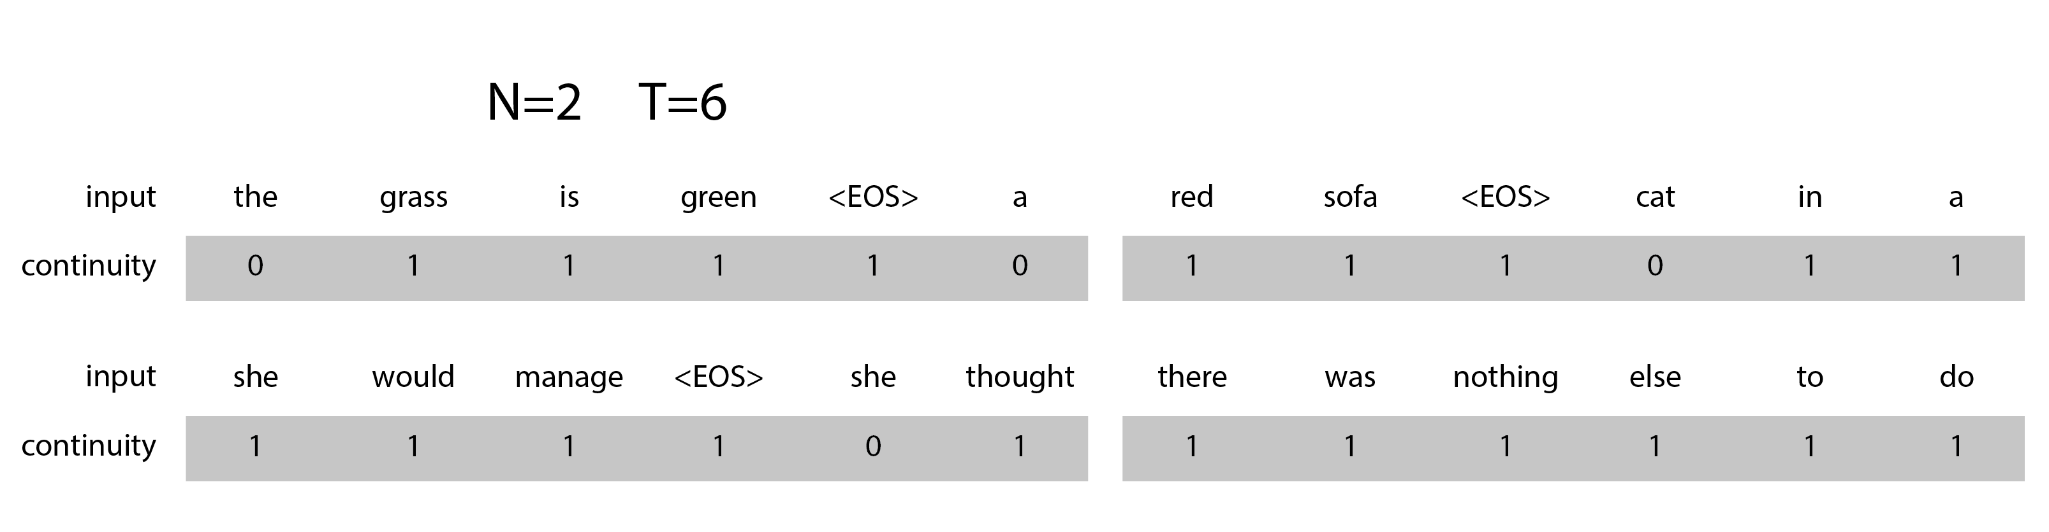
Caffe’s LSTM layer
E.g. for a model that predicts the next word:

Slide 48
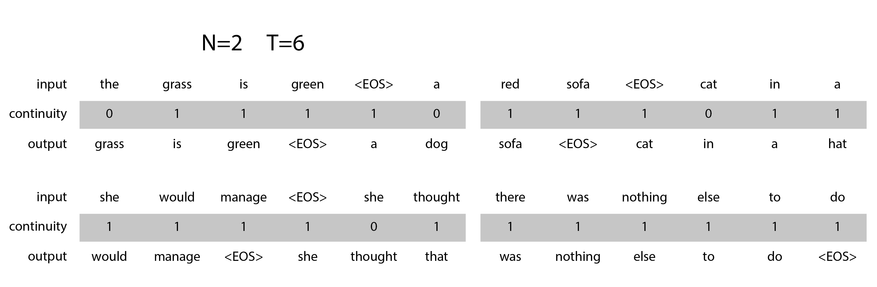
Caffe’s LSTM layer
And including sequence of label for testing:

Slide 49
Caffe’s LSTM layer
It’s TxNx… for computational efficiency
Batch size limits the size of T instead
Backpropagation is approximate - truncated at batch boundaries
Increasing N still means more sequences processed at the same time

Slide 50
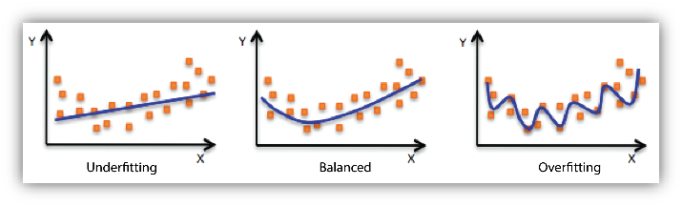
Overfitting
Learns the ‘data’ not the underlying function
The model cannot generalise and performs poorly with new data
[http://docs.aws.amazon.com/machine-learning/latest/dg/model-fit-underfitting-vs-overfitting.html]

Slide 51
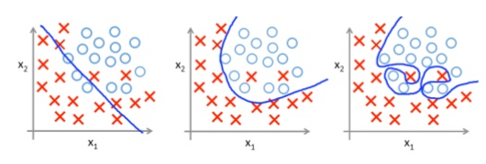
Overfitting
Learns the ‘data’ not the underlying function
The model cannot generalise and performs poorly with new data
[https://www.slideshare.net/fcollova/introduction-to-neural-network]

Slide 52
Overfitting
Common prevention approaches:
Use a separate ‘test’ dataset to check for overfitting
Regularization, penalising large weights, see L2 regularization
regularization_type: “L2” and weight_decay: 0.001 (in solver)
param { decay_mult: 1 } (in layers)
Apply transformations/noise to existing data, generating additional dataset
Apply dropout

Slide 53
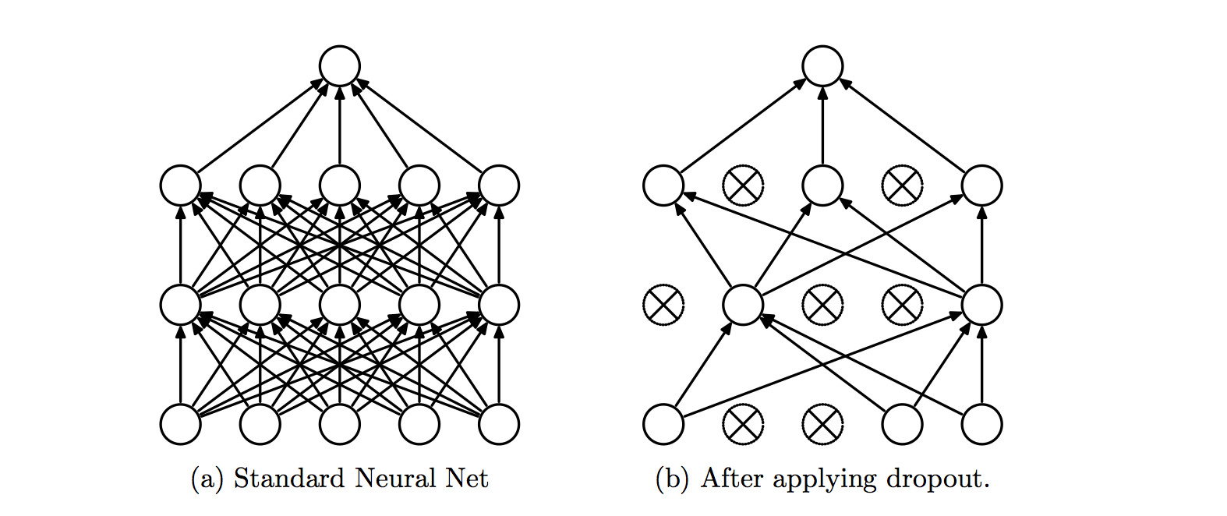
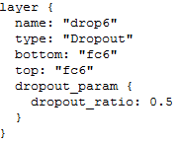
Dropout layer
Prevents overfitting by randomly excluding some neurons during training
Can be used in-place like the activation layers
Only affects the layer below it

Slide 54
Preparing your data
Caffe can take raw images and inputs from interfaces with the ImageData or Input layers

Slide 55
Preparing your data
Database layer:
LMDB – Memory mapped, db can be larger than system memory, fast reads, but less flexible
LevelDB – More efficient storage, a little slower to read than LMDB
HDF5Data layer:
HDF5 – Simpler to use and more flexible but slower, must read entire DB to memory
Data can be chunked however
[https://www.influxdata.com/benchmarking-leveldb-vs-rocksdb-vs-hyperleveldb-vs-lmdb-performance-for-influxdb]

Slide 56
Preparing your data
Database and HDF5Data layers have a ‘source’ field
Points to a .txt file with a list of files to use

Slide 57
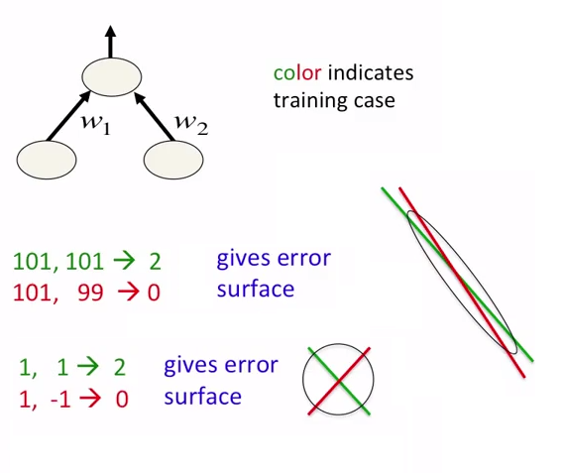
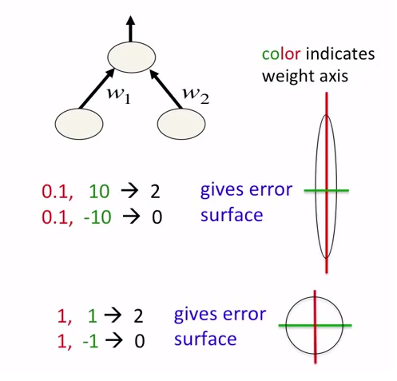
Preparing your data
Scaling your inputs
Inputs as floating point values
Normalization gives a better error surface and reduces training time
Convert your data to be around range of -1 and +1 with the mean being near 0

Slide 58
Preparing your data
Additional dataset can be created by applying noise, rotation, position shift, scaling, etc.
Making the most of existing dataset
Helps with feature invariancy
Reduces overfitting

Slide 59
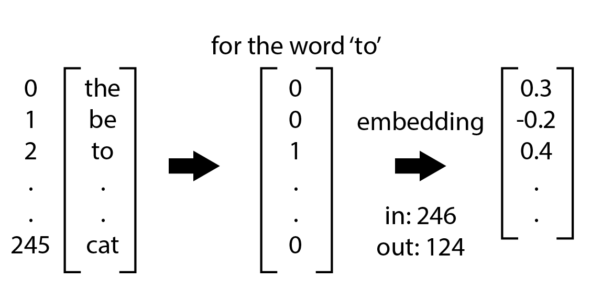
Preparing your data – Language Models
Words or characters are generally encoded in to indices
Embedding layer is used to transform text to a vector in continuous space
Input from DB is supplied as single index integer

Slide 60
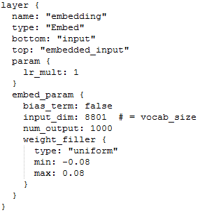
Preparing your data – Language Models
Embedding layer is used to transform text to a lower dimensional vector in continuous space
Input from DB is supplied as single index integer

Slide 61
Preparing your data – Classification Labels
Output labels are encoded as one-hot arrays
Caffe knows the number of classification by the last layer’s output
So in the database we can just give an index number and Caffe expands it for you

Slide 62
LSTM text generation model
Use LSTM to generate a random sequence of characters resembling the original text
Training data can be any body of text
We’ll use Alice in Wonderland as an example
Starts off the prediction by giving it a seed text

Slide 63
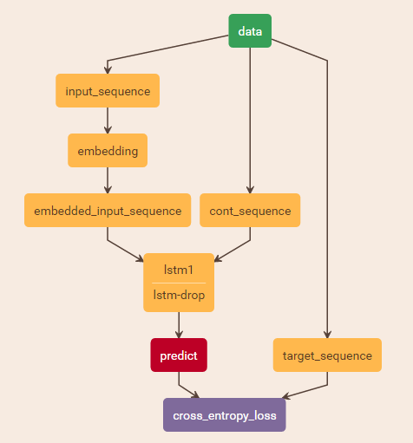
LSTM text generation model
Layer sequence:
HDF5Data
Embed
LSTM
Dropout
InnerProduct
SoftmaxWithLoss

Slide 64
LSTM text generation model
Input is a sequence of characters
No test phase as we’re not concerned with accuracy
Starts by using a sequence of seed text

Slide 65
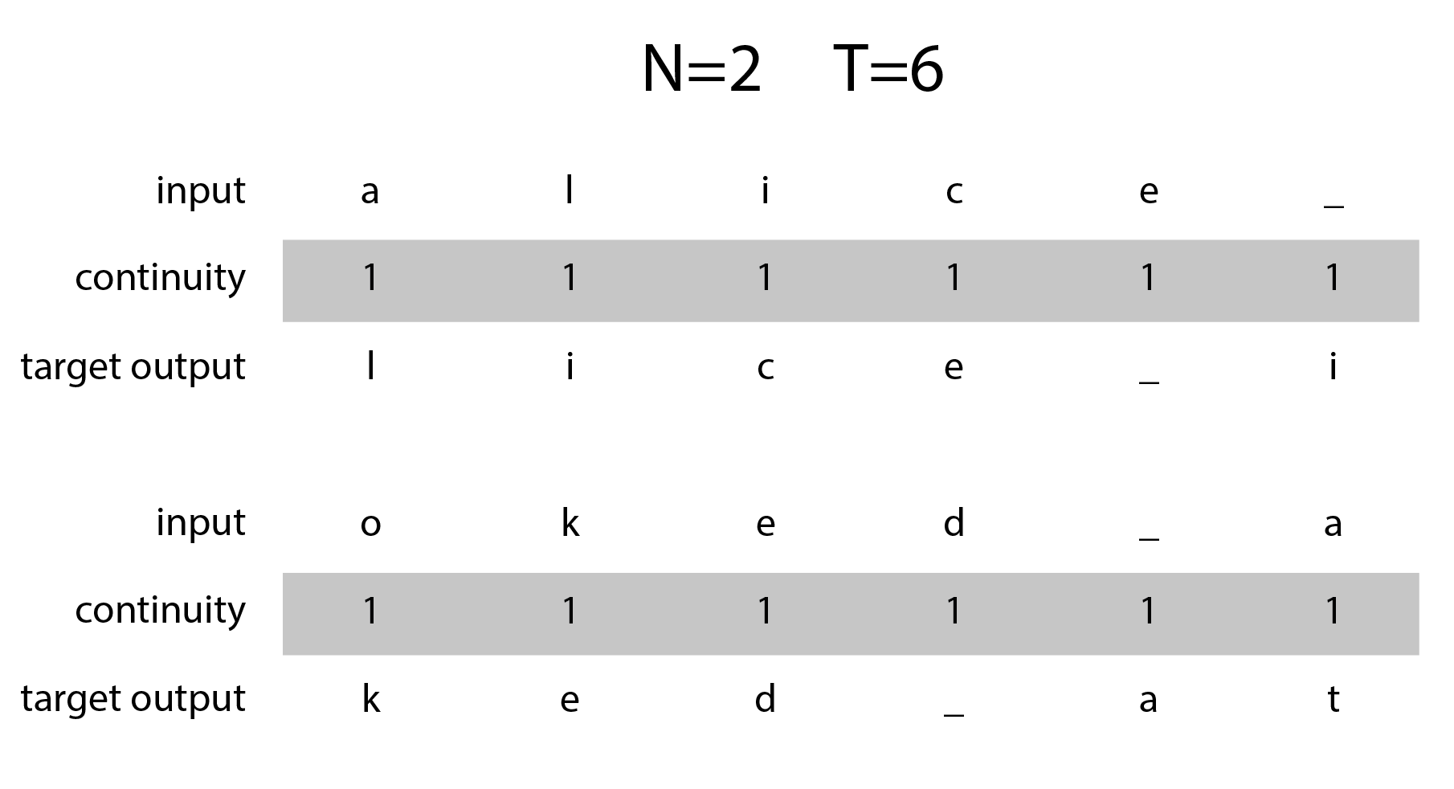
LSTM text generation model
A sample data set with target label:
Continuity data is set to 1 for all sequences

Slide 66
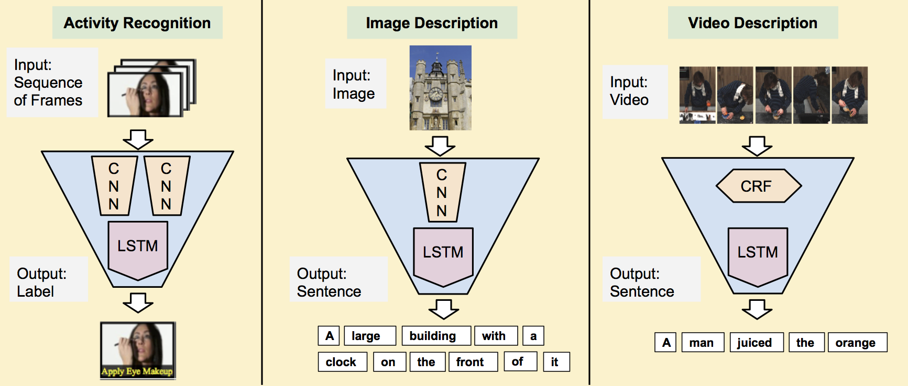
Recurrent convolution networks
Visit Jeff Donahue’s website http://jeffdonahue.com/lrcn/

Slide 67
Practical Lab 06

Slide 68
Before we finish…
Docker images are available for Caffe (and DIGITS).
It’s the most hassle free way to try Caffe on your machine.

Slide 69
Before we finish…
To get a DGX-1 account, contact me at:
t.karmakharm@sheffield.ac.uk
Our GPUComputing Github repo is at:
https://github.com/RSE-Sheffield/GPUComputing
Documentation on using the system and installing other DL packages
Raise issues about DGX-1, Deep Learning or other GPU-related topics here
Please help contribute to the documentation & benchmarking

Slide 70
Before we finish…
See our GPU computing website for more course announcements:
http://gpucomputing.shef.ac.uk/

Slide 71
Thank you for attending!

